Slide 1
FCCLA
Abby Ingledue

Slide 2
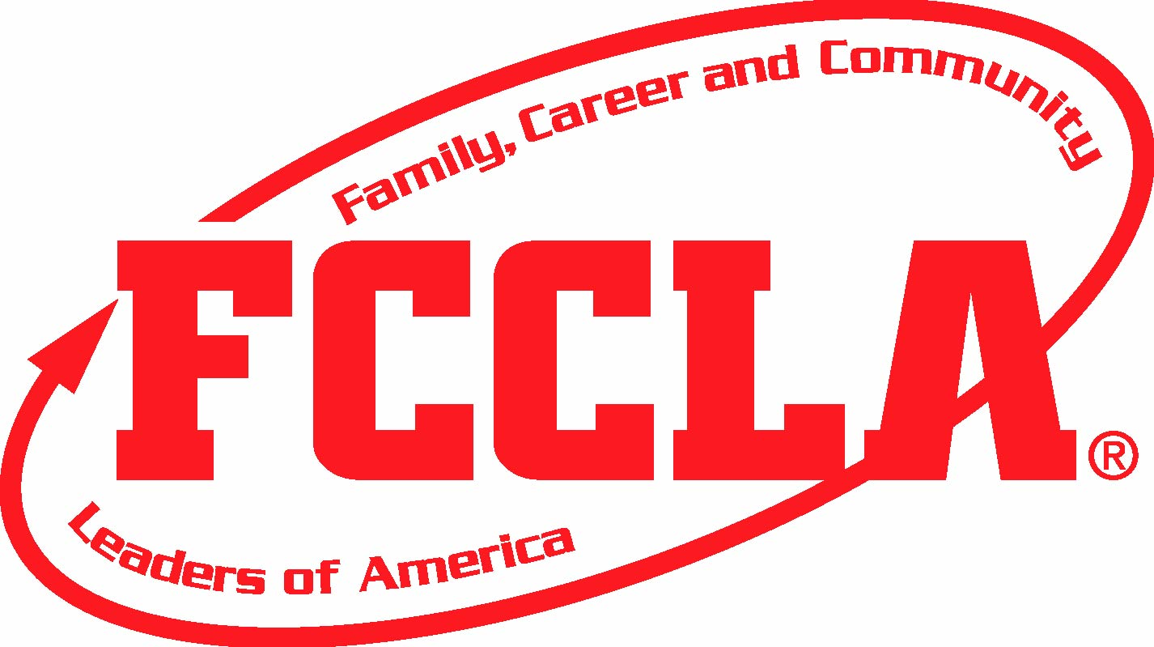
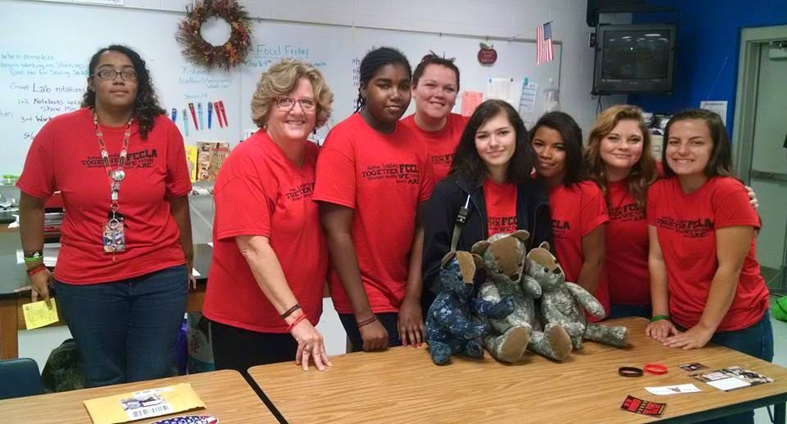
FCCLA stands for Family, Career, and Community Leaders of America
The national CTE organization for junior and senior high school students enrolled in family and consumer sciences occupations education.
The organization’s goal is to help youth assume active roles in society as wage earners, community leaders, and family members.
FCCLA is a nonprofit national vocational student organization for young men and women in family and consumer sciences education in public and private school through grade 12.

Slide 4
History of FCCLA

Slide 5
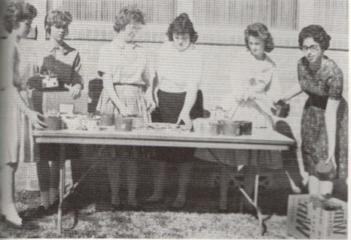
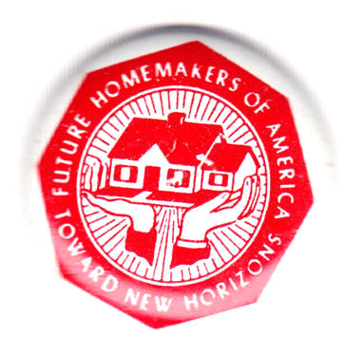
History of fccla
As early as 1920, high school home economics students belonged to home economics clubs.
These clubs included: Junior Homemakers, Betty Lamp Clubs, and Future Homemakers

Slide 6
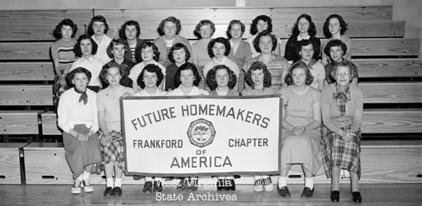
The organization Future Homemakers of America began in 1945.
The New Homemakers of America was a national organization for Black students enrolled in homemaking in 1945 as well.
It wasn’t until 1965 that these two organizations were merged together.

Slide 7
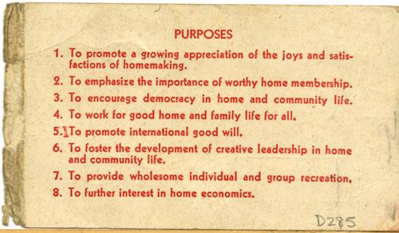

Slide 8
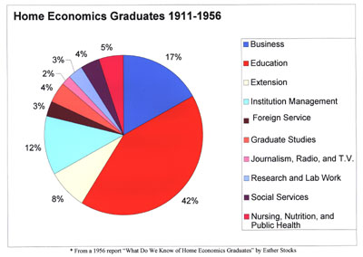
In 1971 FCCLA expanded its organization to include a division of Home Economics Related Occupations, known as HERO; for students studying occupational home economics.
HERO was created for students who intended to be gainfully employed in one of the many subfields of home economics.

Slide 9
Why is fccla important today?

Slide 10
Families
Present vs. Past

Slide 11
Fccla
FCCLA focuses on consumer home economics and on balancing work and family.
FCCLA is the only in-school student organization with the family as its center focus.

Slide 12
Fccla today
Today FCCLA is a dynamic and effective national student organization that helps young men and women become leaders and address important personal, family, work, and societal issues through family and consumer sciences education.
Involvement in FCCLA offers members the opportunity to expand their leadership potential and develop necessary life skills-planning, goal setting, problem solving, decision making and interpersonal communication-in the home and workplace.

Slide 13
FCCLA Covers
Chapter projects focus on a variety of youth concerns, including:
Teen pregnancy
Parenting
Family relationships
Substance abuse
Peer pressure
Environment
Nutrition and fitness
Teen violence
Career exploration

