Slide 1
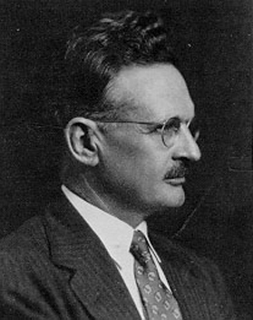
George S. Counts
Educational Giant Presentation ED 200
Abby Shockley

Slide 2
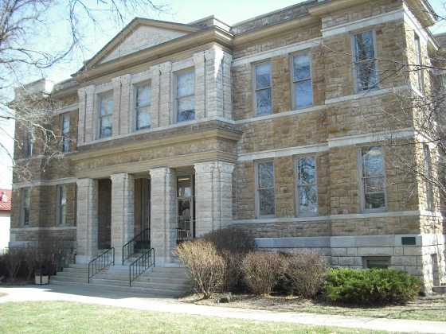
George S. Count’s Biography
Born on a farm near Baldwin City, Kansas, on December 9, 1889
His first, real education consisted of two years spent in a one-room school house.
He completed his education in the public schools of Baldwin City, graduating in 1907 from high school.
He attended college at Baker University in Baldwin Kansas, where he graduated head of his class in 1911.

Slide 3
George S. Counts Begins His Career
He taught science and mathematics for a year at Sumner County high school in Wellington, Kansas.
The very next year he was hired as a teacher and school principal at the high school in Peabody, Kansas.
His experience with teaching and school administration helped Counts decide to advance his study in education, attending the graduate school of the University of Chicago in 1913.
Counts received his Ph.D. with honors in 1916
After graduation he became head of the department of education and director of the summer school at Delaware College in Newark.

Slide 4
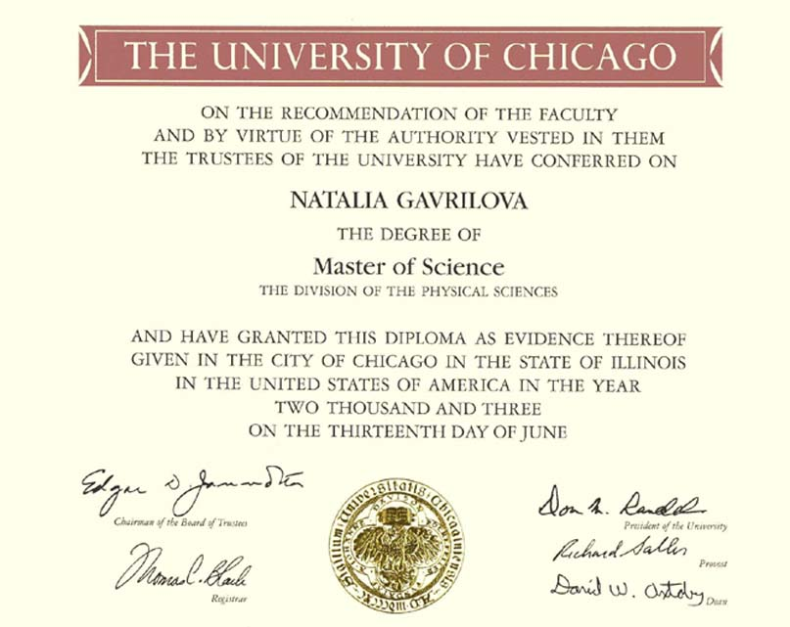
George S. Counts Career
The next ten years after receiving his Ph. D., he held teaching posts at Harris Teachers College, St. Louis, the University of Washington; Yale University, and the University of Chicago.
In 1927 he became a member of the faculty at Teachers College, Columbia University.
He served as associate director of the International Institute from 1927 to 1932 and as professor of education until his retirement in 1956.
He lectured at Harvard, Illinois, Michigan, Stanford, and Virginia.

Slide 5
George S. Counts Contribution
George Counts wrote "Dare the School Build a New Social Order?"
President of the American Federation of Teachers from 1939 to 1942
George was active in American Academy of Political and Social Science, the American Association of University Professors, the American Civil Liberties Union, the American Federation of Teachers, the American Historical Association, the American Sociology Society, the Liberal Party of New York State, the National Education Association, and the Progressive Education Association.
Author of 29 books and over 100 articles

Slide 6
George S. Count’s Philosophy
He was a Social Reconstructionist
His ideas were influenced by John Dewey and Francis W. Parker
He believed teachers should lead
Schools must shape attitudes, develop tastes, and impose ideas
Schools must build our civilization
Prepare individuals to adjust to social change

Slide 7
George S. Counts Quotes
“An education that does not strive to promote the fullest and most thorough understanding of the world is not worthy of the name.”
“The weakness of Progressive Education thus lies in the fact that is has elaborated no theory of social welfare, unless it be that of anarchy or extreme individualism.”
“Under certain conditions education may be as beneficent and as powerful as we are won’t to think. But if it is to be so, teachers must abandon much of their easy optimism, subject the concept of education to the most rigorous scrutiny, and be prepared to deal much more fundamentally, realistically, positively with the American social situation than has been their habit in the past.”

Slide 8
Application to the Present/Influence
Empowered the teachers
Brought the importance of school in society to the attention of the public
Taught and enforced that everyone has a right to an equal education
Helped get the government on board with their responsibility in education

Slide 9
Personal Impact
He has made me realize how important it is for students today to understand and acknowledge the world and our society.
He has helped me understand exactly what a Social Reconstructionist stood for and believed in.
He is an excellent example to me of how one person can have a huge affect on our world.
His thoughts and opinions have changed education forever and because of him I am able to see education in a new light.

Slide 10
References
Crutchfield, C. (2014). George S. Counts. Www2.southeastern.edu. Retrieved 13 October 2014, from http://www2.southeastern.edu/Academics/Faculty/nadams/educ692/Counts.html
Teeter, C. (2004). GEORGE COUNTS the founder of Modern American Education.. Freerepublic.com. Retrieved 13 October 2014, from http://www.freerepublic.com/focus/f-news/1079317/posts
Biography.yourdictionary.com,. (2014). George S. Counts Facts. Retrieved 13 October 2014, from http://biography.yourdictionary.com/george-s-counts

